Slide 1






ALEX AGENCY COMPANY
Team 292
ALEX AGENCY ANALYTICS
Ahmed Mamdouh
Jasser Ashraf
Mohamed Salah
Omar Mohamed
Saaed Mohamed
Youssef Mohamed
DATA-DRIVEN PERFORMANCE
Efficiency and Speed in Modern Logistics
Let’s Move

Slide 2


ALEX AGENCY COMPANY
Contact
INTRODUCTION
Understanding The Core Of Business Model
Alex Agency is a large B2B Wholesaler such as Alibaba for example that provides a big variety of many goods and also a shipping and logistics solutions to all of it’s partners that located in Europe, North America and South America

Slide 3
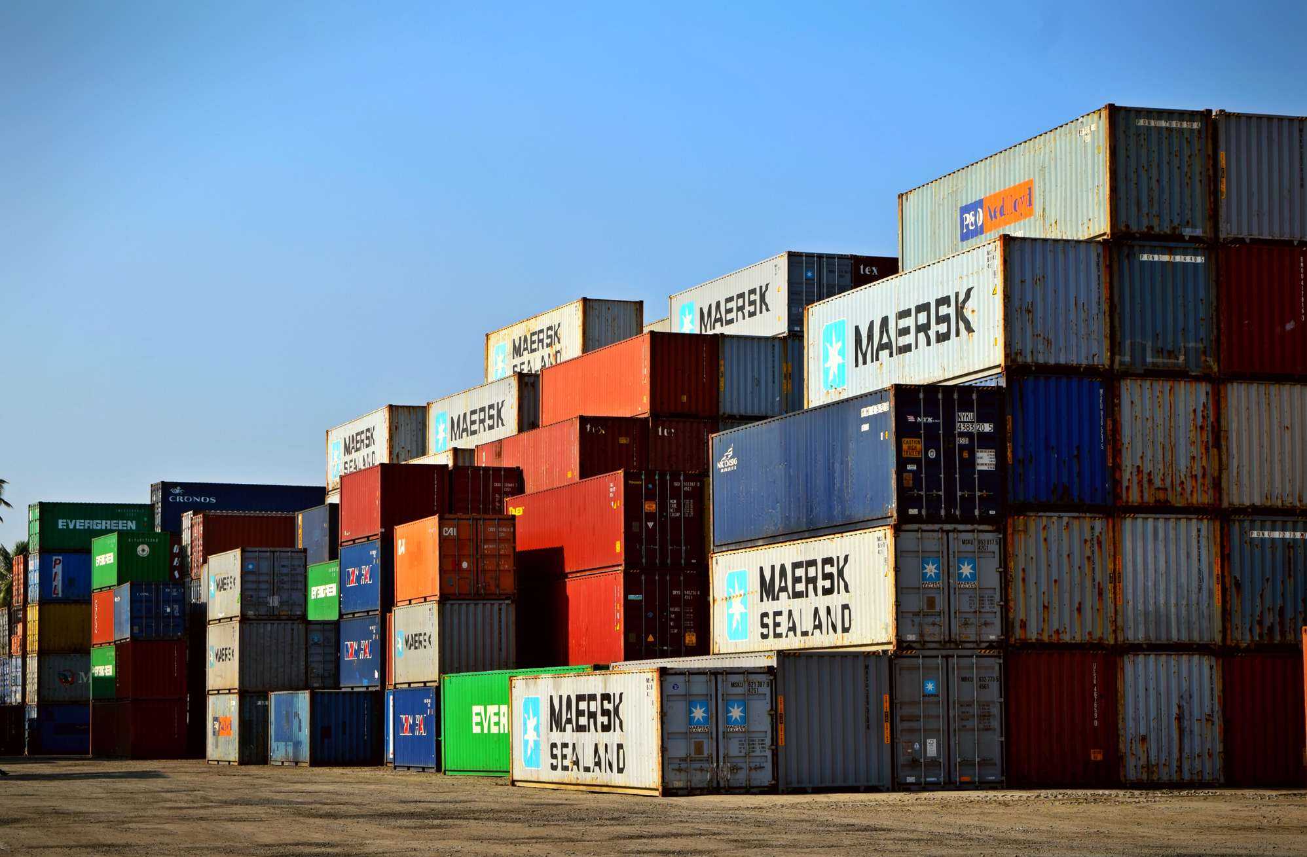
ALEX AGENCY COMPANY
Defining the Wholesaler
WHOLESALER DEFINITIONS AND COMPONENTS
A wholesaler is a merchant middleman or company that buys products in large quantities (bulk) from manufacturers or producers and then sells them to other businesses, primarily retailers, for resale or business use.
The wholesale business model is inherently Business-to-Business (B2B).
Key Components
Suppliers
Distributors
Customers
Manufacturers
Retailers

Slide 4
ALEX AGENCY COMPANY
Transportation Management and Inventory Control
These two areas focus on the physical and temporal location of goods. Transportation Management handles the efficient movement of inventory across the network, while Inventory Control determines the optimal stock levels to meet demand while minimizing holding costs. Their coordination is essential, linking warehouse locations to distribution requirements.
Transportation Management
Inventory Control
Warehouse Operations & Information Technology
Warehouse Operations manage the physical receipt, storage, and movement of goods within the facility. This physical activity is managed and optimized by Information Technology (IT), which includes systems like WMS and data analysis tools. IT provides the crucial real-time visibility and communication needed to streamline the complex processes of the warehouse
Warehouse Operations
Information Technology
FACTORS THAT AFFECT LOGISTICS EFFICIENCY

Slide 5

ALEX AGENCY COMPANY
Contact
POWER BI
CASE STUDY
Star schema model
Key dimension buttons include:
Sales trend analysis
Customer insights
Product performance
Shipping & delivery
Geographical analysis
Employee performance
Deep dive analysis
Comprehensive insights Optimization in a Global Company
Our goal of case study to analyze the business model to Alex company is to provide an overall and complete view to stakeholders that related to this company such as ( Owners, Managemant, Employee...etc)

Slide 6
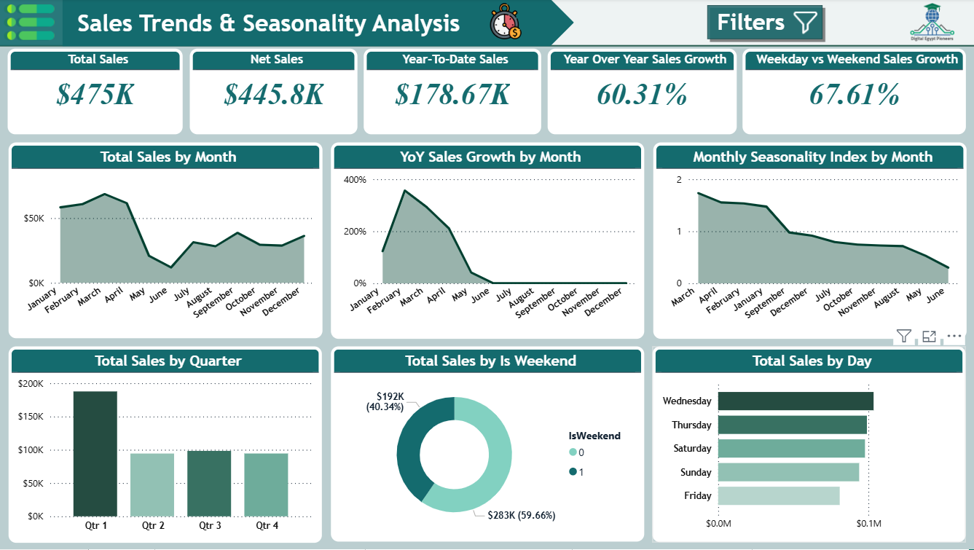
ALEX AGENCY COMPANY
CARDS
Total sales
Net sales
Year to date sales
Year over year sales growth
Weekdays Vs Weekend sales growth percentage
CHARTS
Total sales by Quarter, Month, Day
year over year sales growth by month
Monthly seasonality index by month
Sales in weekdays Vs weekend
SALES TREND ANALYSIS

Slide 7
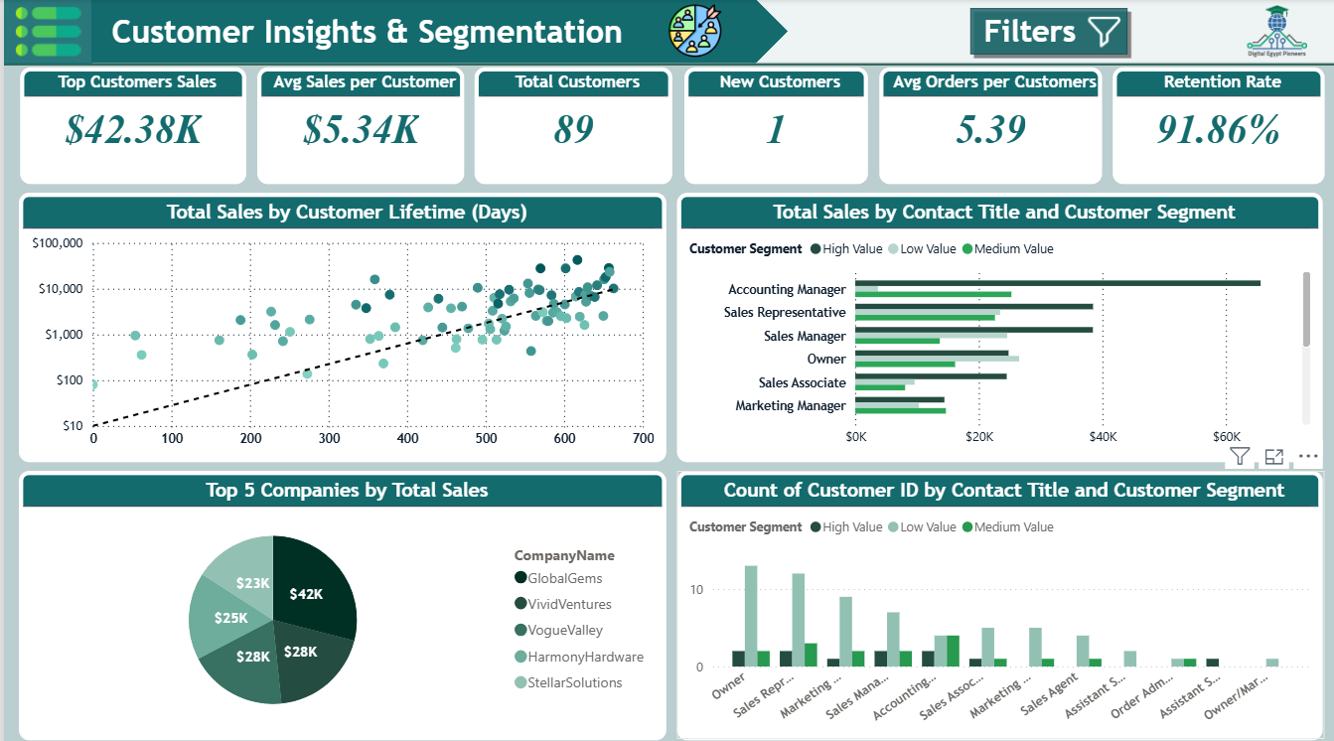
ALEX AGENCY COMPANY
Transportation Management and Inventory Control
These two areas focus on the physical and temporal location of goods. Transportation Management handles the efficient movement of inventory across the network, while Inventory Control determines the optimal stock levels to meet demand while minimizing holding costs. Their coordination is essential, linking warehouse locations to distribution requirements.
No. of customers & total customer Sales
Avg sales & orders by customers
Warehouse Operations & Information Technology
Warehouse Operations manage the physical receipt, storage, and movement of goods within the facility. This physical activity is managed and optimized by Information Technology (IT), which includes systems like WMS and data analysis tools. IT provides the crucial real-time visibility and communication needed to streamline the complex processes of the warehouse
Retention rate
Totals sales by customer lifetime
Contact title Segmentation & sales
CUSTOMER INSGHTS & SEGMENTATION
Top 5 copmanies sales

Slide 8
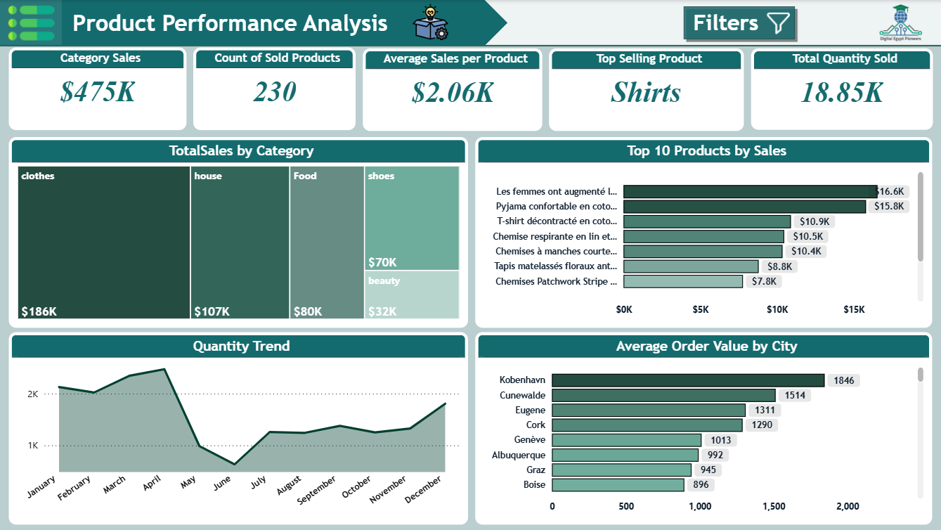
ALEX AGENCY COMPANY
PRODUCT PERFORMANCE ANALYSIS
Top sales by category
Top 10 selling products
Avg sales per prodcuts
No.of products

Slide 9
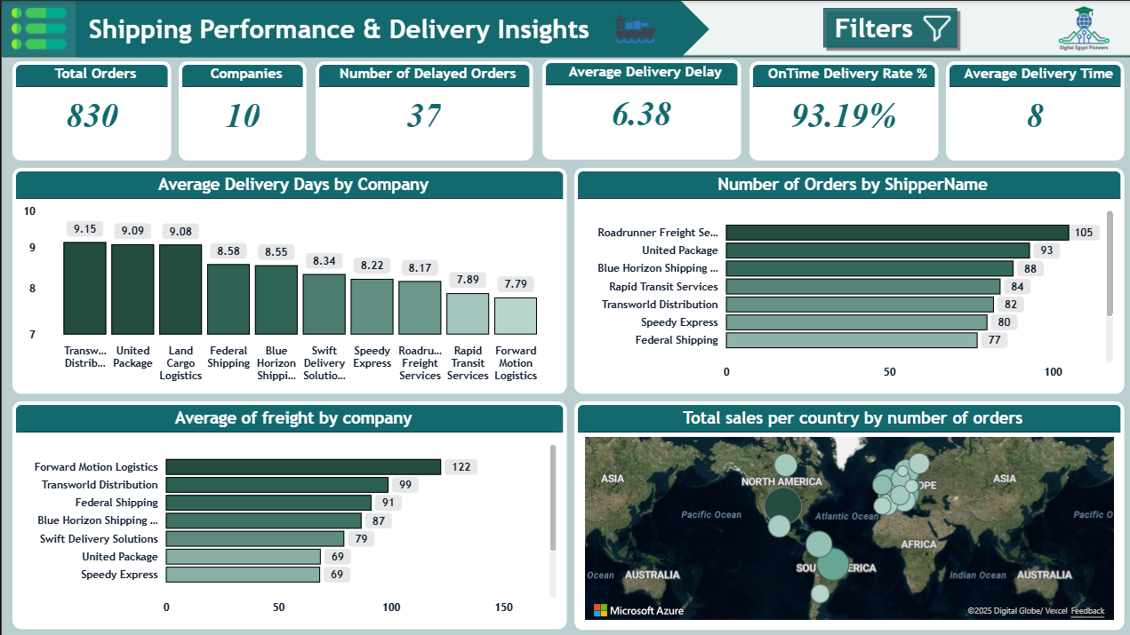
ALEX AGENCY COMPANY
Shipping insights
Avg Delivery days per company
No. of ordes by shipper
Avg freight by copmany
No. of orders and total sales per country
SHIPPING PERFORMANCE &DELIVERY INSIGHTS

Slide 10
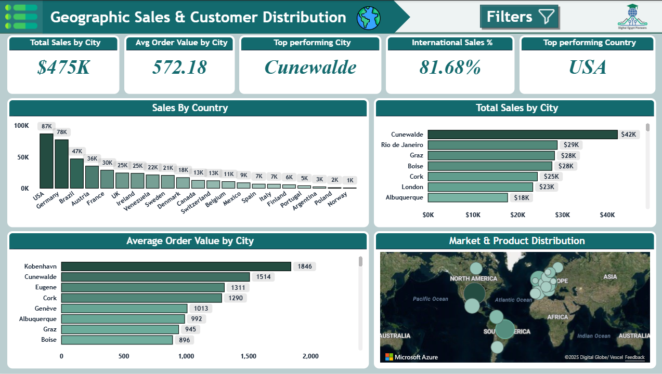
ALEX AGENCY COMPANY
Transportation Management and Inventory Control
These two areas focus on the physical and temporal location of goods. Transportation Management handles the efficient movement of inventory across the network, while Inventory Control determines the optimal stock levels to meet demand while minimizing holding costs. Their coordination is essential, linking warehouse locations to distribution requirements.
Top performing country & city
Avg sales & orders by customers
Warehouse Operations & Information Technology
Warehouse Operations manage the physical receipt, storage, and movement of goods within the facility. This physical activity is managed and optimized by Information Technology (IT), which includes systems like WMS and data analysis tools. IT provides the crucial real-time visibility and communication needed to streamline the complex processes of the warehouse
Avg order value per city
International sales %
Variety of products per country
GEOGRAPHIC SALES &CUSTOMER DISTRIBUTION
Market & product distribution

Slide 11
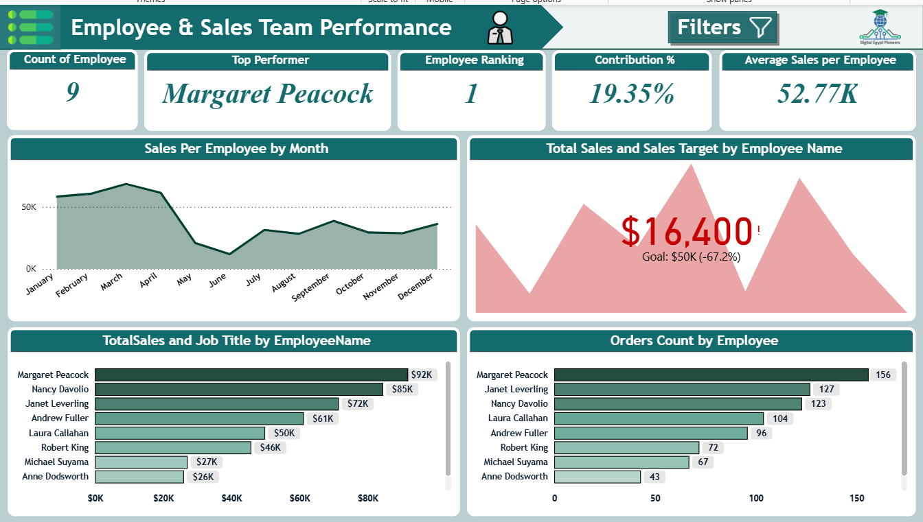
ALEX AGENCY COMPANY
EMPLOYEE &SALES TEAM PERFORMANCE
Employee
ranking
Employee contribution %
Total sales & target per employee
Total orders per employee

Slide 12
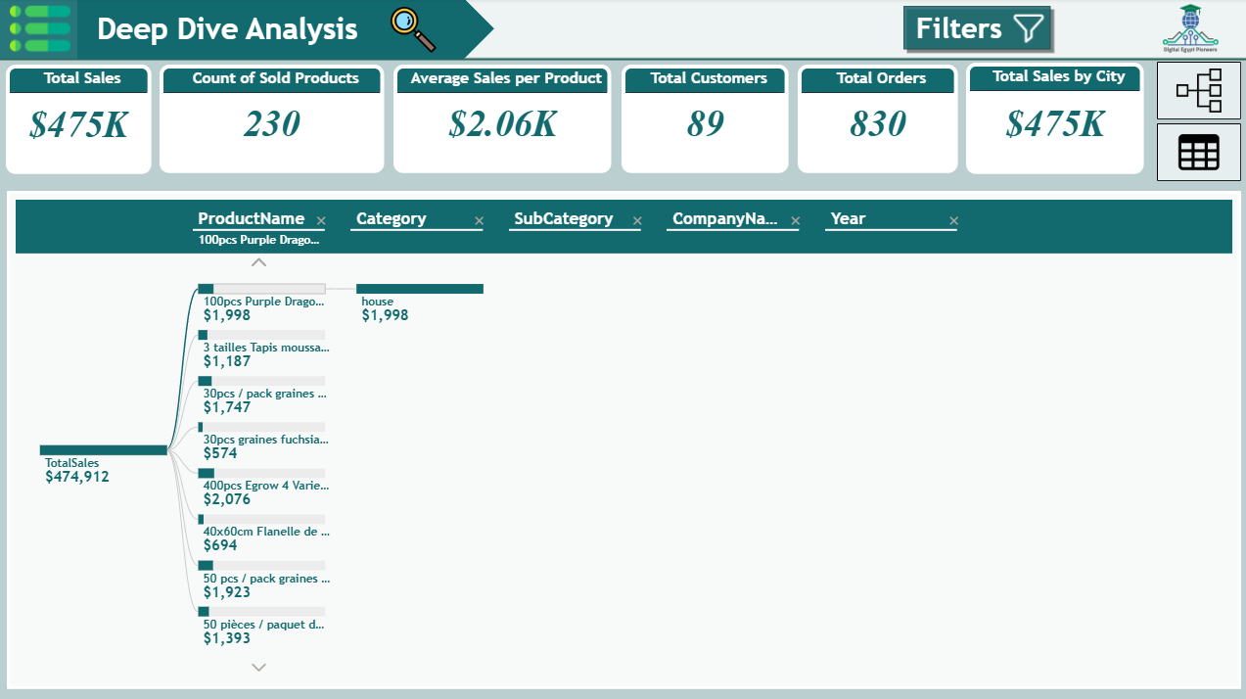
ALEX AGENCY COMPANY
Summary for all you want to know in simple, indicative tree
DEEP DIVE ANALYSIS

Slide 13
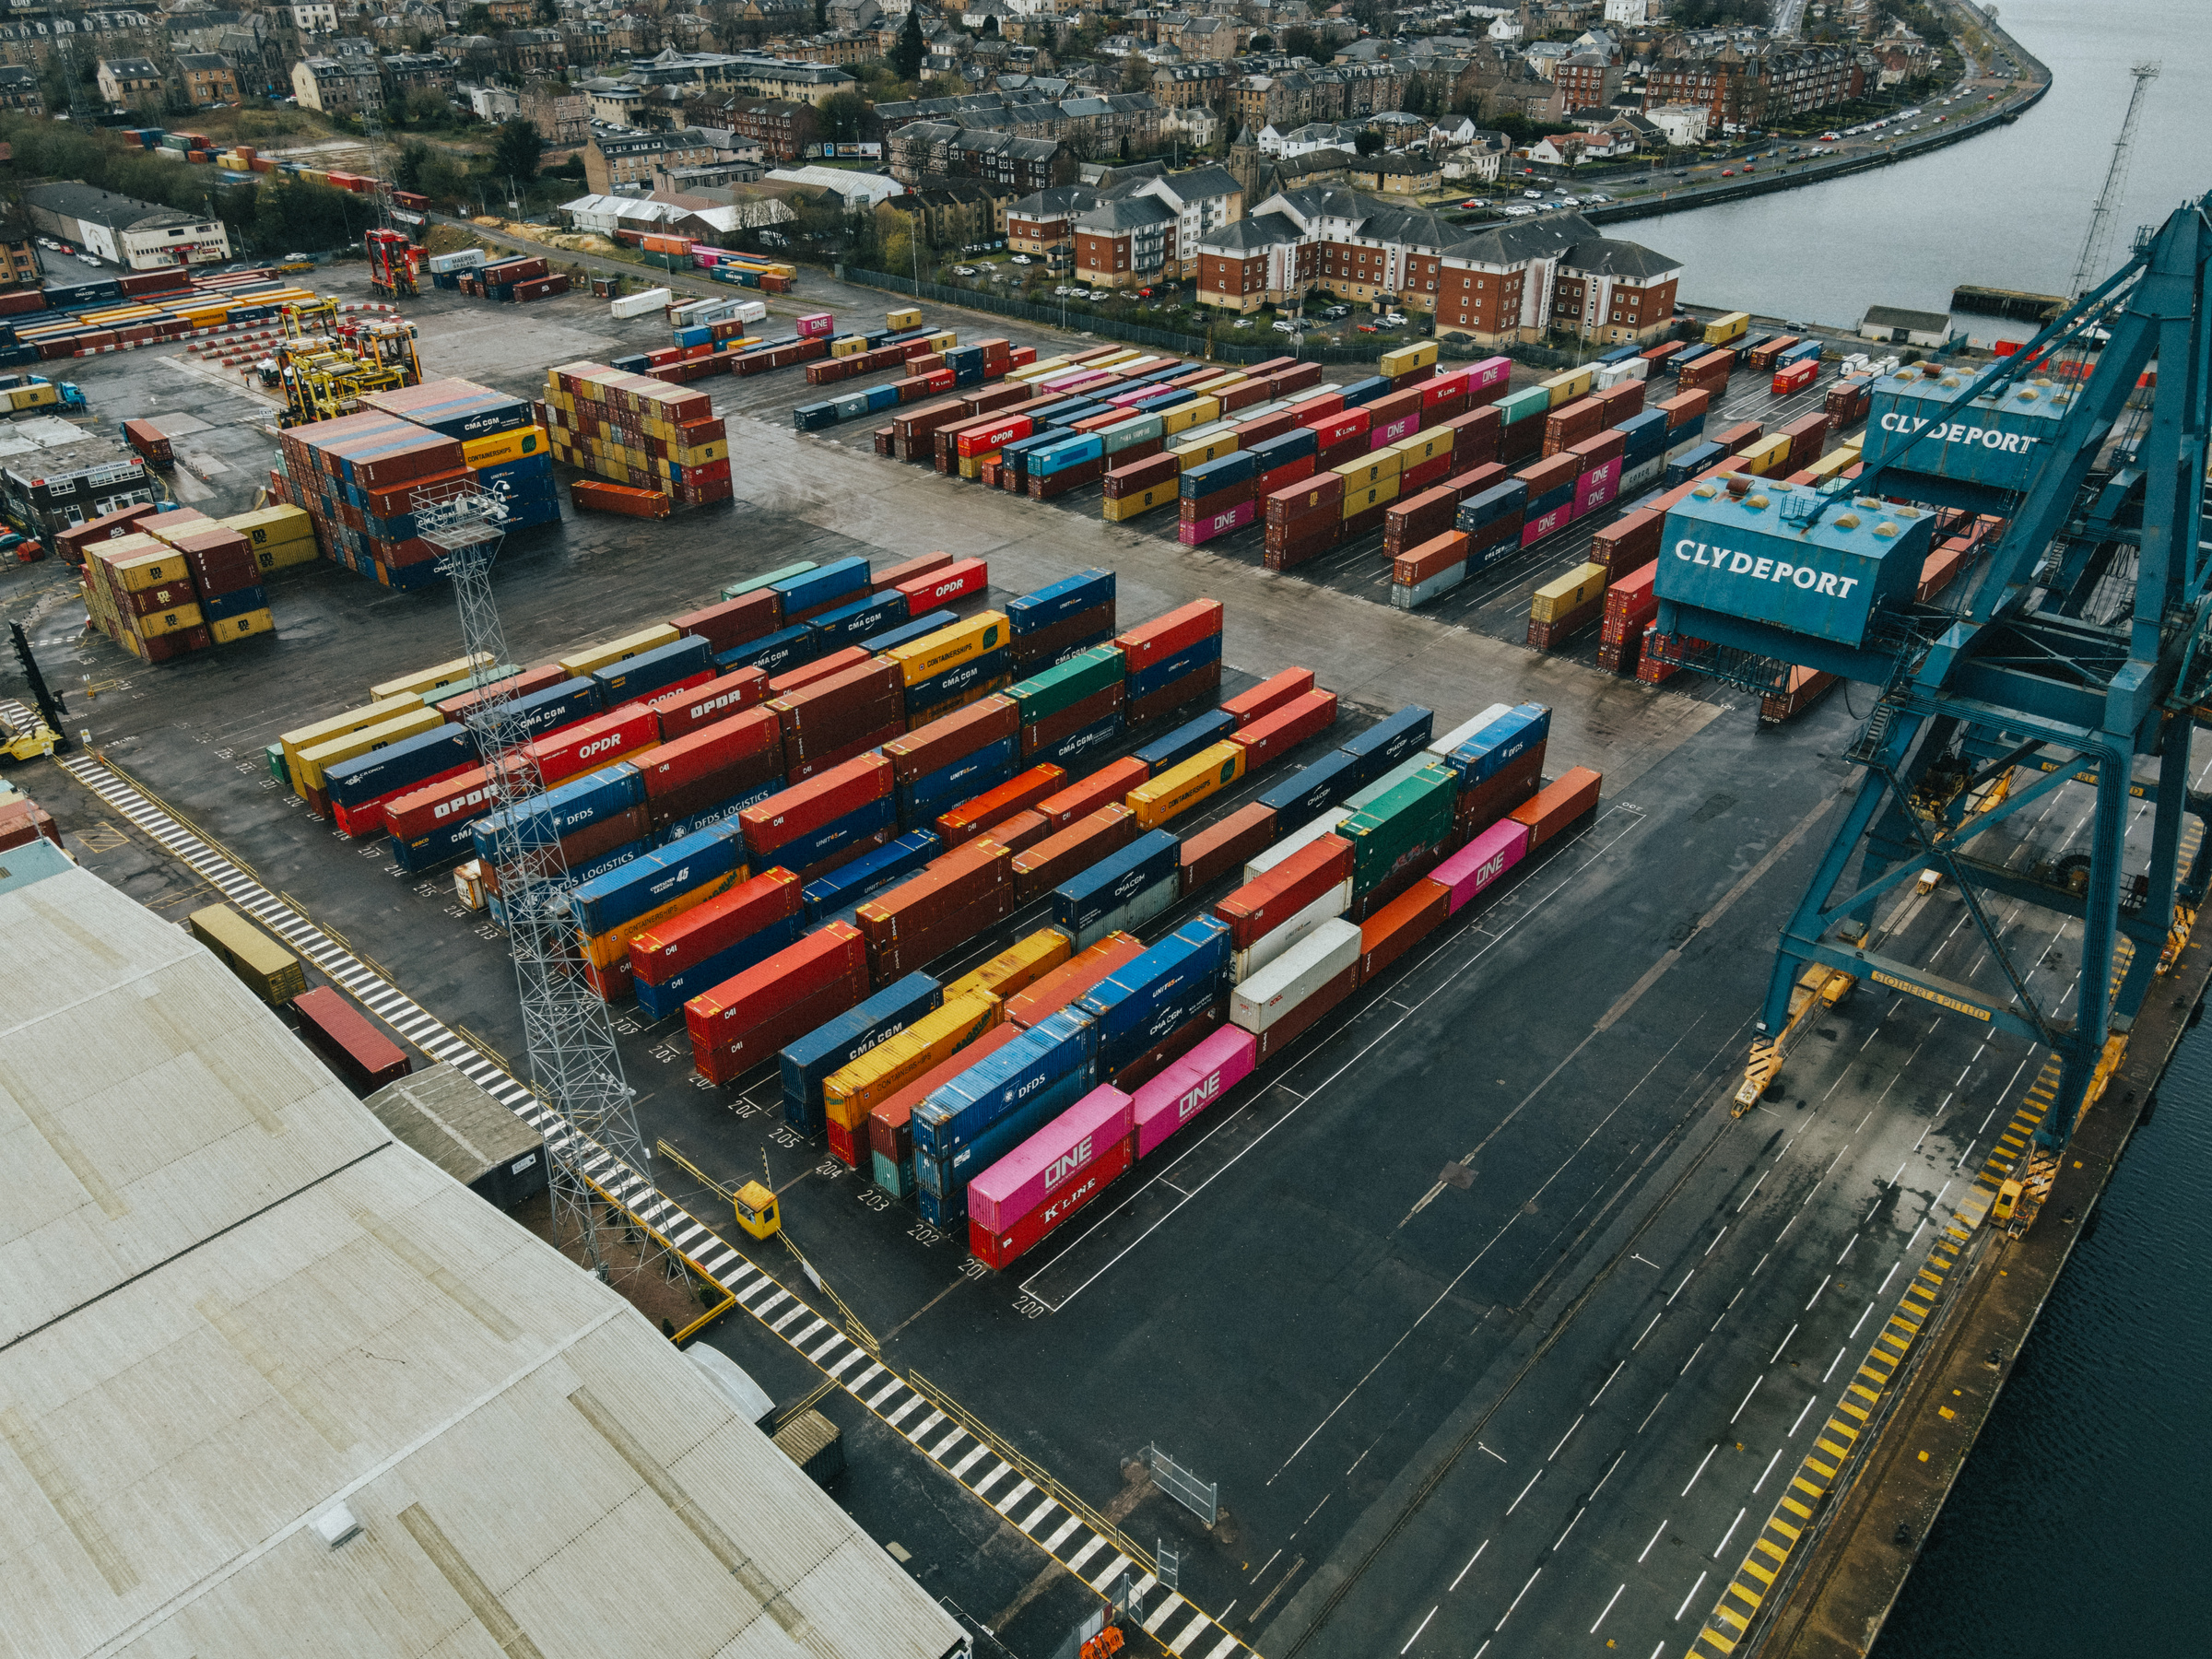
ALEX AGENCY COMPANY
CONCLUSION
The primary challenges in implementing this B2B sales and distribution analytics model center on four key areas: first, difficulty in quantifying the Return on Investment (ROI), as the financial benefits derived from "actionable insights" are indirect and hard to measure against the high initial investment; second, overcoming resistance and ensuring successful adoption across diverse, siloed global sales teams, which demands intensive, costly training, especially concerning transparent metrics like employee performance; third, the inherent conflict between rapid, agile development and the complex foundational work required for data modeling and Extract, Transform, Load (ETL), which slows down feature delivery; and finally, the technical complexity of integrating often legacy B2B systems across multiple international territories to create a unified, accurate, real-time data model.

Slide 14

ALEX AGENCY COMPANY
Contact
SOLUTIONS TO OVERCOME EACH CHALLENGE
Change Management Programs
Cost-Benefit Analysis
Integrated IT Systems
Agile Practices

Slide 15
ALEX AGENCY COMPANY
THANK YOU

